Slide 1


SPRINT D
LAPR4 PROJECT
June 2022
Client presentation
Tiago Marques 1201276
Eduardo Silva 1201371
Pedro Alves 1201381
Pedro Fernandes 1201384

Slide 2
Presentation content
Results achieved
Quality of the final product
Critical analysis of results and teamwork
Suggestions of improvement
Evidence of applying the software engineering /development process
Students' self-assessments
Deployment scenario of the solution
Other theorical aspects

Slide 3

Results achieved
All requested features
implemented and functional
Extra features also
implemented

Slide 4
Critical analysis of results and teamwork
Strengths
Weaknesses
Opportunities
Threats
Documentation
Acquisition of knowledge
Communication between team members
Prices inflaction caused by products scarcity
Inline code documentation
Great demand for products of this type
Project structure
S
W
O
T

Slide 5
Evidence of applying the software engineering /development process
Creating User Stories in Jira
Using bitbucket
User Stories documentation
Unitary commits

Slide 6
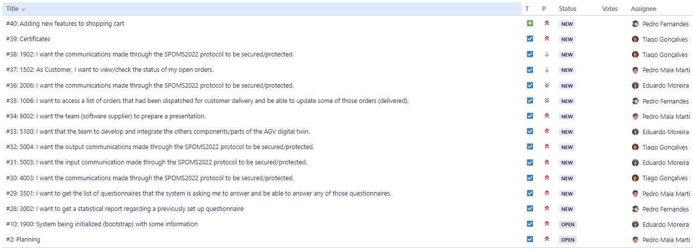
Evidence of applying the software engineering /development process

Slide 7
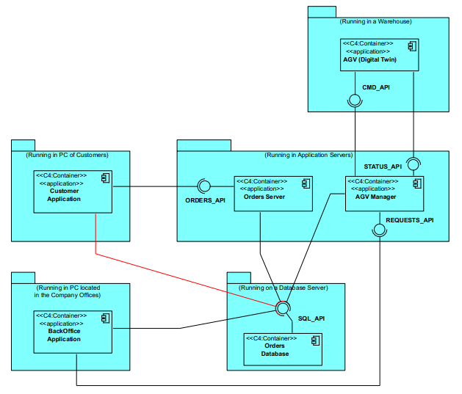
Deployment scenario of the solution
Application
Server
Orders
Costumer
AVG Manager
BackOffice
AGV
(Digital Twin)

Slide 8



Quality of the final product
As we finalized all the requested features and non-requested ones, we believe that the quality of the final product is high.

Slide 9
Suggestions of improvement
Graphical UI
Inline commentaries
Although not in the project requirements, we thought it would be a good improvement to develop a graphical interface.
As mentioned before, we think that one of the aspects that we could improve would be the inline comments of the code.

Slide 10
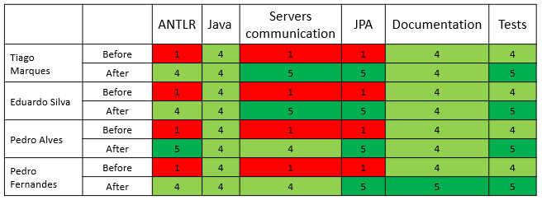
Students' self-assessment
Technical skills

Slide 11
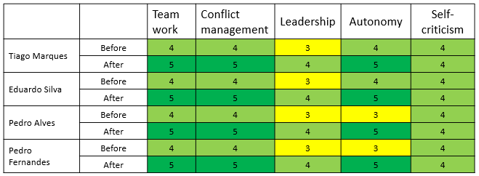
Students' self-assessment
Behavioral skills

Slide 12

LAPR4 skills

Slide 13
Leadership context
Rotative leadership
Each sprint (from 3 to 3 weeks), we changed our leader. We adopted this method so each member of the team could improve his leadership skills.

Slide 14
Leadership focus
Transformational
Personal attention to each member of the team
Encourages pride, earns respect and
confidence in team members
Raises team expectations
Transactional
Liberal

Slide 15
Leadership style
Democratic leadership encourages employees to participate and to give suggestions and opinions. In addition, the democratic leader helps the team develop solutions, is very participative, listens, and offers tips and ideas when necessary. He is concerned with the execution of the work and the quality of life and satisfaction of the team.
Democratic leadership
Democratic leadership

Slide 16


Tuckman stages of team development
Forming
Storming
Norming
Performing
Adjourning
Identification of project objectives,
putting the structure of the team together
Definition of responsibilities of team members.
It can occur some conflicts, as the individual personalities and work styles clash within the team.
Definition of the work process.
Team members are exploring new ways of doing and working together.
High productivity,
execution and
improvement of
process.
A highly productive stage for the team.
End of
process.
Final tasks and documentation are completed.

Slide 17

Reflection
With this project, we were all able to develop teamwork skills, and we were all able to acquire knowledge of software development and new technologies.

Slide 18
Thank you!
The end

